Slide 1
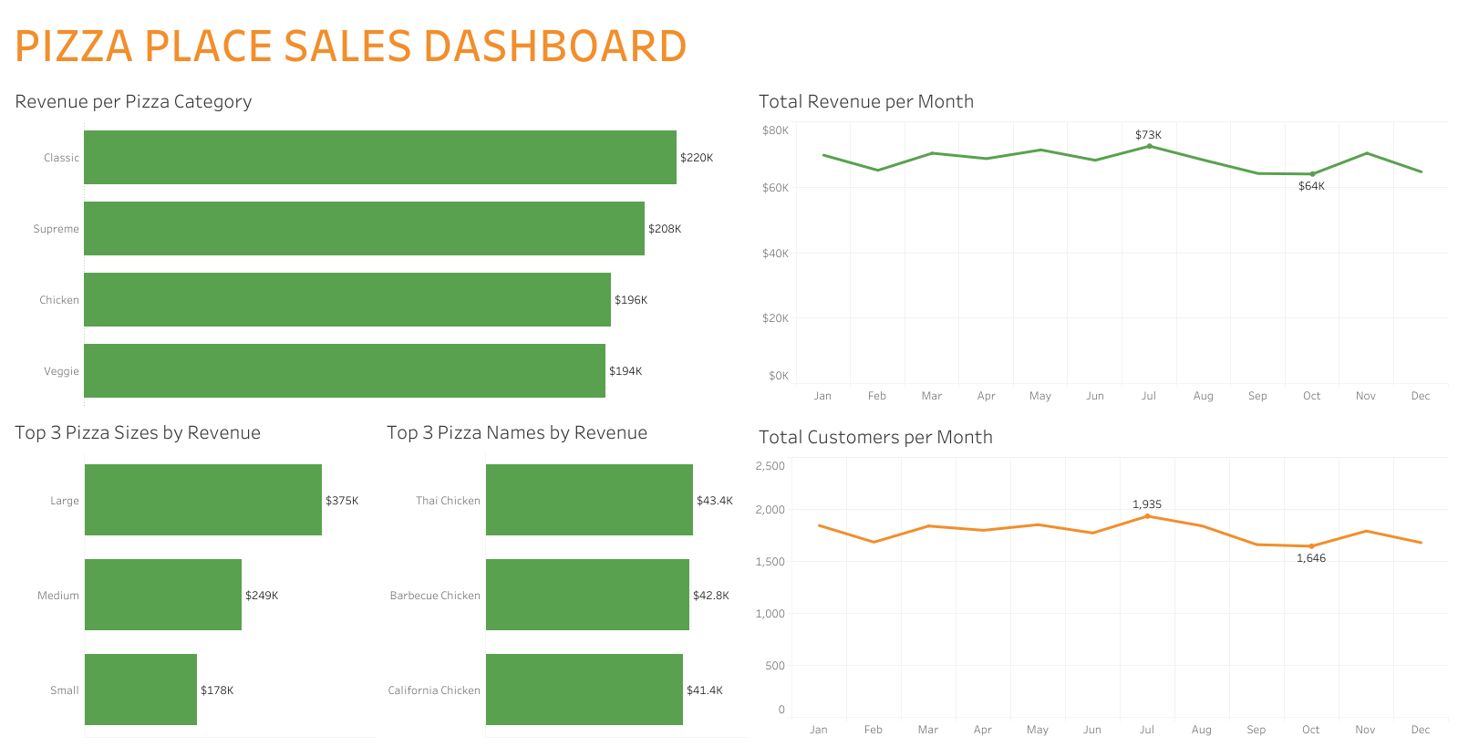

Slide 2
Abstract
I performed a product sales analysis on a dataset from a fictitious pizza place.
The dataset contains four related tables on pizza sales in 2015.
I used Microsoft Excel to clean the data.
I exported the cleaned data to Tableau to conduct my analysis.

Slide 3
Data-Cleaning Strategy
I decided not to analyze the pizza ingredients.
This type of analysis requires culinary skills
Culinary skills are beyond the scope of my knowledge.
I only analyzed the pizza categories.
I decided not to analyze the pizza order times.
I only performed a month-over-month product sales analysis.
I changed the values of the pizza sizes.
I changed the values to the actual names of the pizza sizes.
I removed redundant words from the pizza names.
(i.e., “the” and “pizza”)

Slide 4
Key Questions
Revenue:
Which pizza category drove the most revenue?
Which pizza size drove the most revenue?
Which pizza name drove the most revenue?
How much revenue was generated each month?
Sales:
Which pizza category drove the most sales?
Which pizza size drove the most sales?
How many customers were served each month?

Slide 5
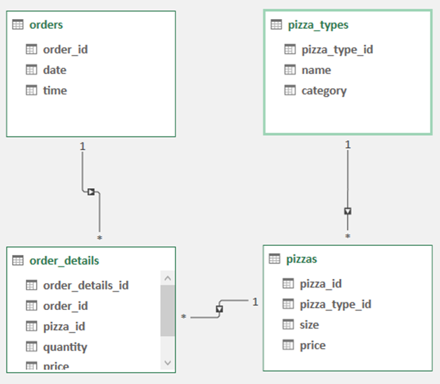
Data Model

Slide 6
Insights
Revenue:
Classic pizzas drove the most revenue at %220K.
Large pizzas drove the most revenue at $375K.
The Thai Chicken Pizza drove the most revenue at $43.4K
The total revenue generated month-over-month stayed relatively constant.
The maximum revenue was generated in July at $73K.
The minimum revenue was generated in October at $64K.
Sales:
Classic pizzas drove the most sales.
Large pizzas drove the most sales.
The number of customers served month-over-month also stayed relatively constant.
The maximum number of customers served occurred in July at 1,935.
The minimum number of customers served occurred in October at 1,646.

Slide 7
Recommendations
Upsell on Large Pizzas.
These pizzas performed the best in terms of revenue and sales.
Focus primarily on the Thai Chicken Pizza.
This pizza generated the most revenue for the business.
Remove Large and Extra-Large Pizzas from the menu.
These pizzas did not perform well in terms of revenue and sales.
Make sure that the business is fully staffed in July.
July is the busiest month for the business.
Both revenue and number of customers served were at maximum during this month.

